Slide 1
Data Science With R
Summer Training ETP VIVA
Made by Gibran Khan Tareen
Registration Number: 12100173

Slide 2

Certificate from The Institution

Slide 3
Table of contents
A Brief Introduction
Important Concepts
01
02
Few Glimpses
Presenting Project Report
03
04
About the main objectives of our project and language used
Discuss the important concepts used in the project
Of important outcomes which we found during the Project
Finally I will show my project report, source code and execution

Slide 4
— Ronald Coase, Economics, Nobel prize Laureate
“Torture the data,
and it will confess
to anything.”

Slide 5
01
A Brief Introduction
What are the Project Objectives
and Language We Used In It

Slide 6
Basic Structure of Our Dataset
Attributes | Description
AGE | Age of the patient discharged
FEMALE | A binary variable that indicates if the patient is female
LOS | Length of stay in days
RACE | Race of the patient (specified numerically)
TOTCH | Hospital discharge costs
APRDRG | All Patient Refined Diagnosis Related Groups

Slide 7
Main Objectives of Our Project
Record Patient Stats
Check For Malpractice
Allocation of resources
Find Main Cost Factors
Find which age category most frequently visit the hospital and
has the maximum expenditure
Find if there is any malpractice going on by analyzing the race of the patient is related to the hospitalization costs.
To properly utilize the costs, the agency has to analyze the severity of the hospital costs by age and gender.
To perform a complete analysis, the agency wants to find the variable(s)
that mainly affect hospital costs.

Slide 8
Language Used for our Project:
R
R is the most popular language in the world of Data Science. It is heavily used in analyzing data that is both structured and unstructured. This has made R, the standard language for performing statistical operations. R allows various features that set it apart from other Data Science languages.

Slide 9
02
Important Concepts
Now we will Discuss the important
concepts used in the project

Slide 10
Important Concepts Used
Hypothesis Test
Anova Testing
Linear Regression
Its is a method of statistical inference used to decide whether the data at hand sufficiently support a particular hypothesis.
Analysis of variance is used to investigate relations between categorical variables and continuous variable
It is a statistical approach for modeling the relationship between a dependent variable and a given set of independent variables.

Slide 11
Where did I Implement These Concepts?
 | Description | Implemented In
Hypothesis Test | An act in statistics whereby an analyst tests an assumption regarding a population parameter. It provides evidence concerning the plausibility of the hypothesis, given the data. | We used concept of Hypothesis testing using ANNOVA Testing in our Goal 3
Annova Testing | It is a type of hypothesis testing for population variance used to find the relations between categorical variables and continuous variable in R Programming | We implemented ANNOVA Testing in our Goal 3
Linear Regression | It is a commonly used type of predictive analysis. It is a statistical method that allows us to summarize and study relationships between two continuous (quantitative) variables | We implemented Linear Regression by using our own Model in Goal 4, 5 and 6

Slide 12
03
Few Glimpses of Outcomes
We will now see some important outcomes which we found during the Project

Slide 13
Screenshot: Patient Statistics

Slide 14
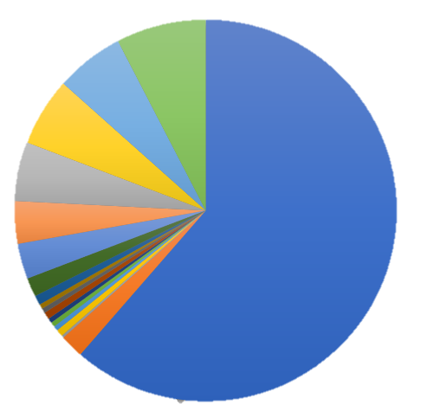
Patient Statistics Maximum Patients Top 3 Age Groups
61%
08%
06%
Age GROUP 0
Has Maximum Patients
GROUP 0
Age GROUP 1
Age GROUP 2

Slide 15
Screenshot: Patient Statistics

Slide 16
₹678,118
AGE group 0 has the maximum Hospital expenditure

Slide 17
Screenshot of Check for Malpractice

Slide 18

Check for Malpractice ANNOVA TESTING
Total No. of Races
6
Dependent Var.
TOTCH
Change impact
Low
Medium
High
the “F value” is quite low (0.244). This clearly indicates that the variation between hospitalization costs among different races is very small as compared to the variation of hospitalization costs within each race.
The p-value (labeled Pr > F) is greater than Significance value ie. Alpha (0.05) and the “Residual values” (deviation of the observed values) was quite high, so both of these Observations indicate that there is no relationship between race and hospital costs, thereby accepting the Null hypothesis.
DF
F
MEAN
SUM SQ
We observed that we have more data for RACE 1
(484 out of 500 patients) in comparison to all other races. This makes the observations biased.
We conclude by saying “There is Insufficient data
to verify if a patient’s race affects his expenditure.”
Notes:
An F-statistic greater than the critical value is equivalent to a p-value less than alpha and both mean that you reject the null hypothesis

Slide 19
Screenshot of Finding Main Cost Factor(s)

Slide 20

Finding Main Variables Which Are Affecting Cost Factors
 | Variable Factor | Impact | Level of Impact
1 | AGE |  | Very High
2 | FEMALE |  | Very Low
3 | LOS (Length of Stay) |  | Very High
4 | RACE |  | Very Low
5 | APRDRG (All Patient Refined Diagnosis Related Groups) |  | Medium

Slide 21
Thank You!
This Shall be it for the Presentation Part. I will now show the Project Report and Source Code

Slide 22
04
Presenting Project Report
Project report, Source code
and execution

